Slide 1
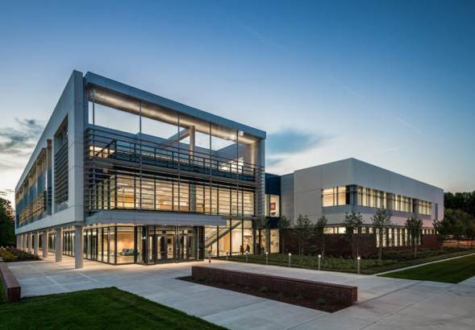
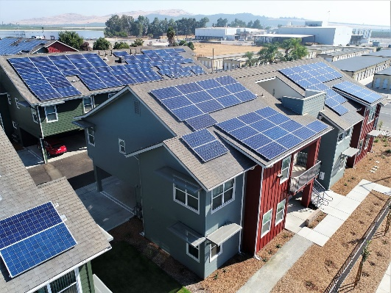
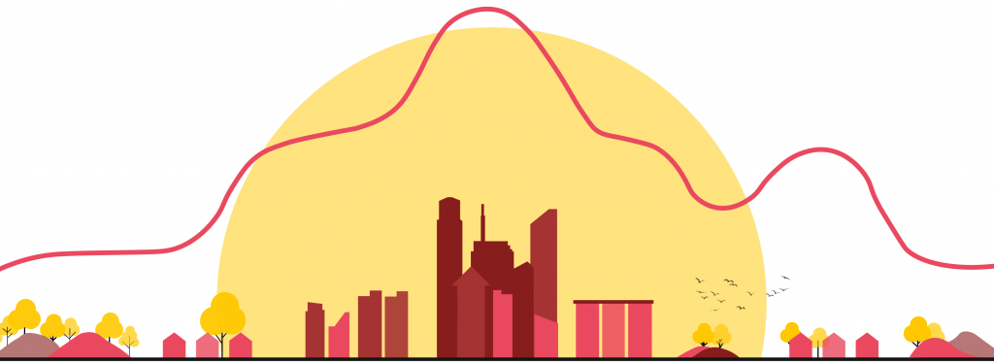
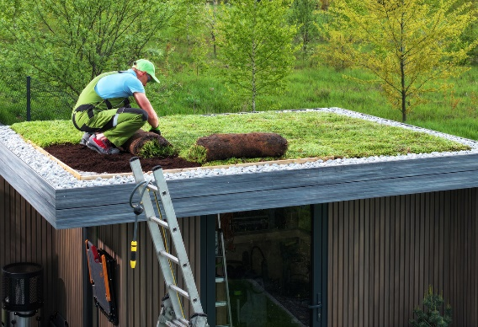
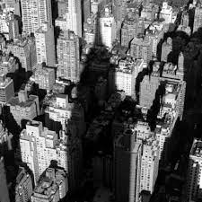


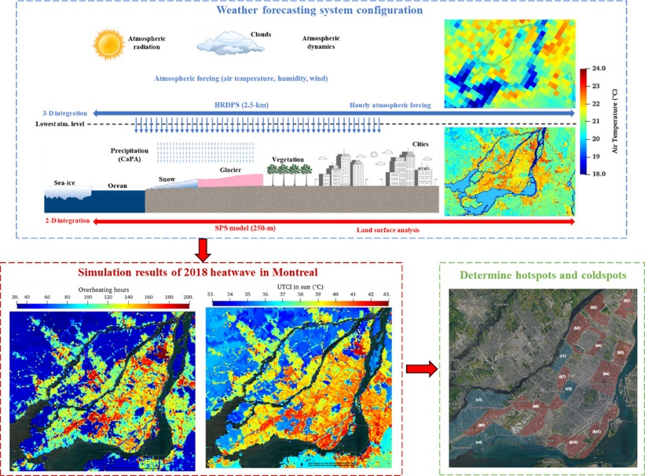
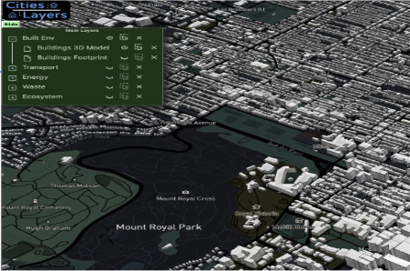
Bottom-up building energy prediction
Urban rooftop PV retrofitting
Data exchange with microclimate models
CityBEM
Urban green roof retrofitting
Developed in
Inter-building shading impacts
Data exchange with weather forecasting models
Integrated with other UBEMs like tools4cities

Slide 3
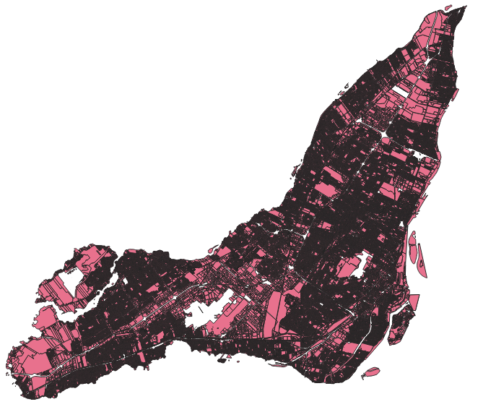
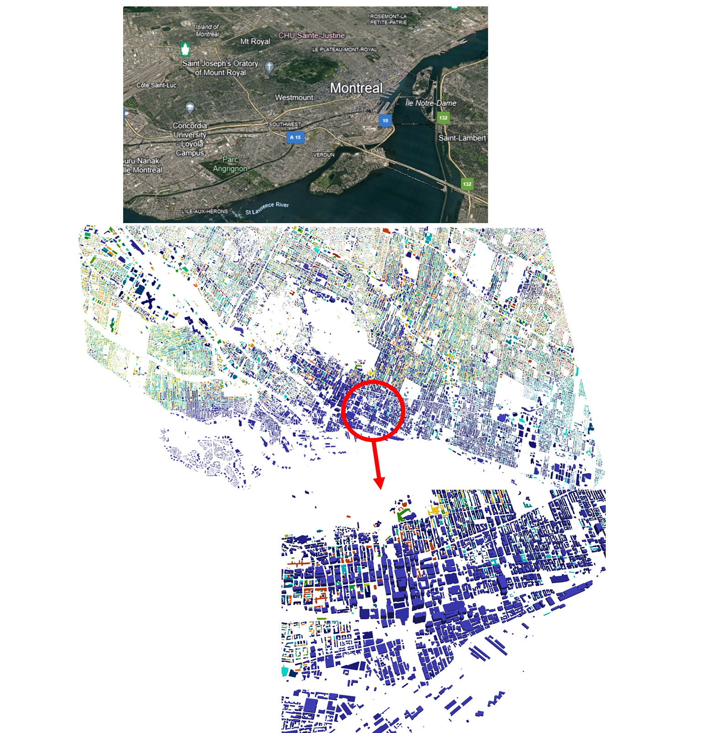
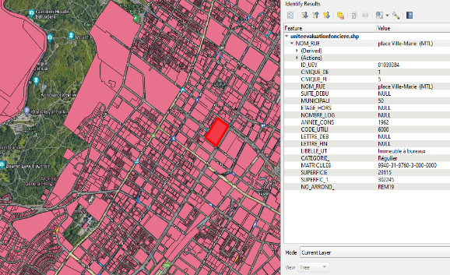
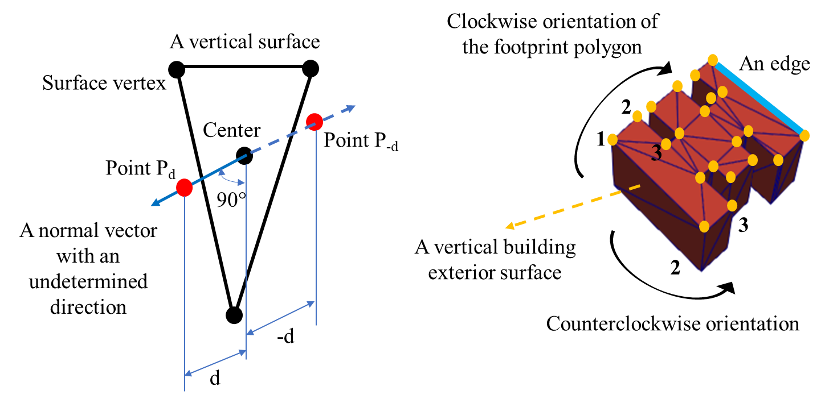
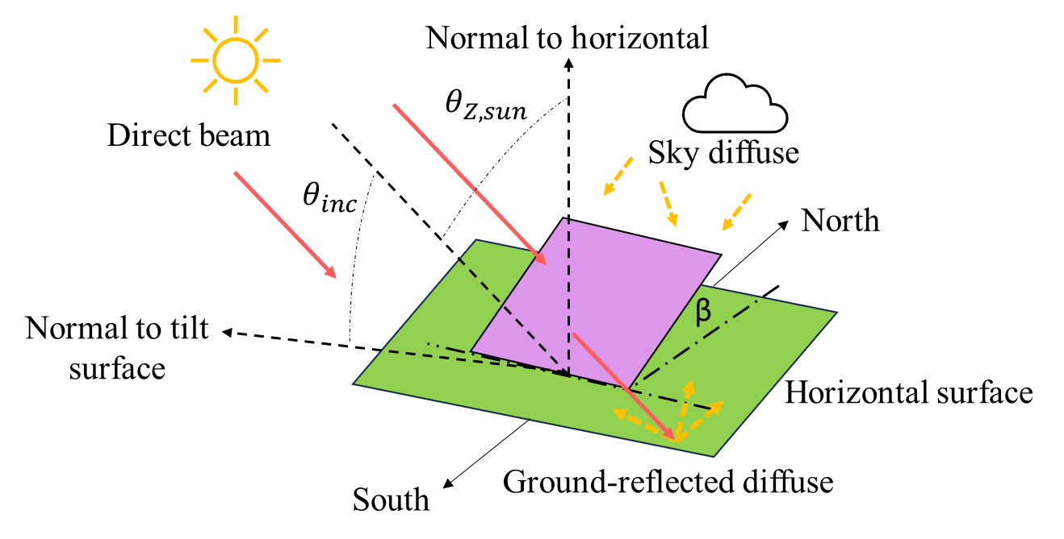
Urban Building Info (usage type, age, etc.)
3D City Geometry Processing
Surface by Surface Modeling
Detailed Solar Radiation Modeling

Slide 4


Slide 5
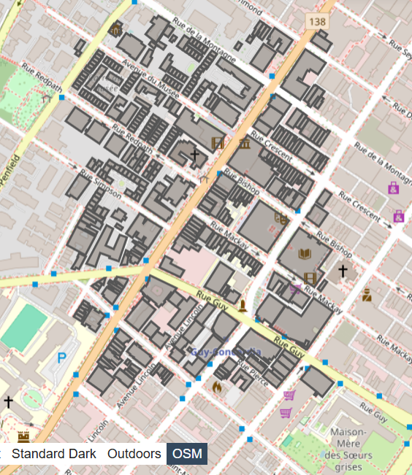
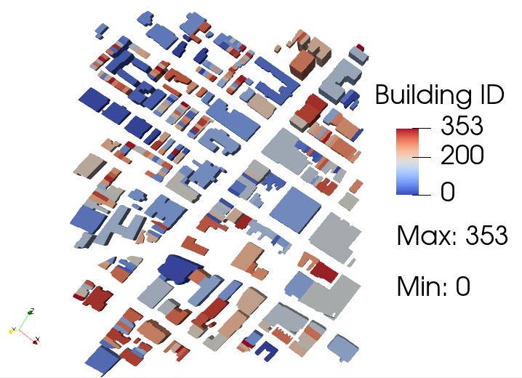

Slide 6
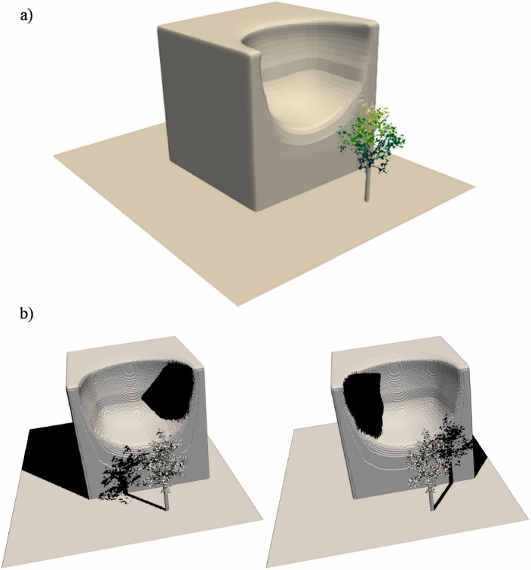
3D shading model
Urban 3D shading modeling

Slide 7
Annual EUI results
EUI of Montreal buildings

Slide 9

Modeling building energy self-sufficiency of using rooftop photovoltaics on an urban scale
Presented by: Saeed Rayegan, PhD Candidate
Supervisors: Prof. Leon Wang, Prof. Radu Zmeureanu
Concordia University, Department of Building Engineering

Slide 10
Building Energy Models (UBEMs): Essential Tools for Carbon Neutrality
Citywide Energy Insights: UBEMs simulate the energy use of entire building stocks, revealing high-impact areas for improvement.
Scenario-Based Planning: Enable testing of various retrofit/decarbonization strategies (e.g., rooftop PV, insulation, electrification).
Scalable and Adaptable: Applicable from neighborhood to city scales with integration of local building data and outdoor climate inputs.
Demand-Responsive Grid-Integration: Enable coordination with smart grid systems and demand-response strategies for sustainable urban energy management.
Support for Policy & Decision-Making: Provide regional-specific data for city planners and policymakers to design effective carbon reduction policies.
Monitoring Progress Toward Goals: Facilitate tracking of GHG emissions reduction over time to ensure alignment with carbon neutrality targets.

Slide 11
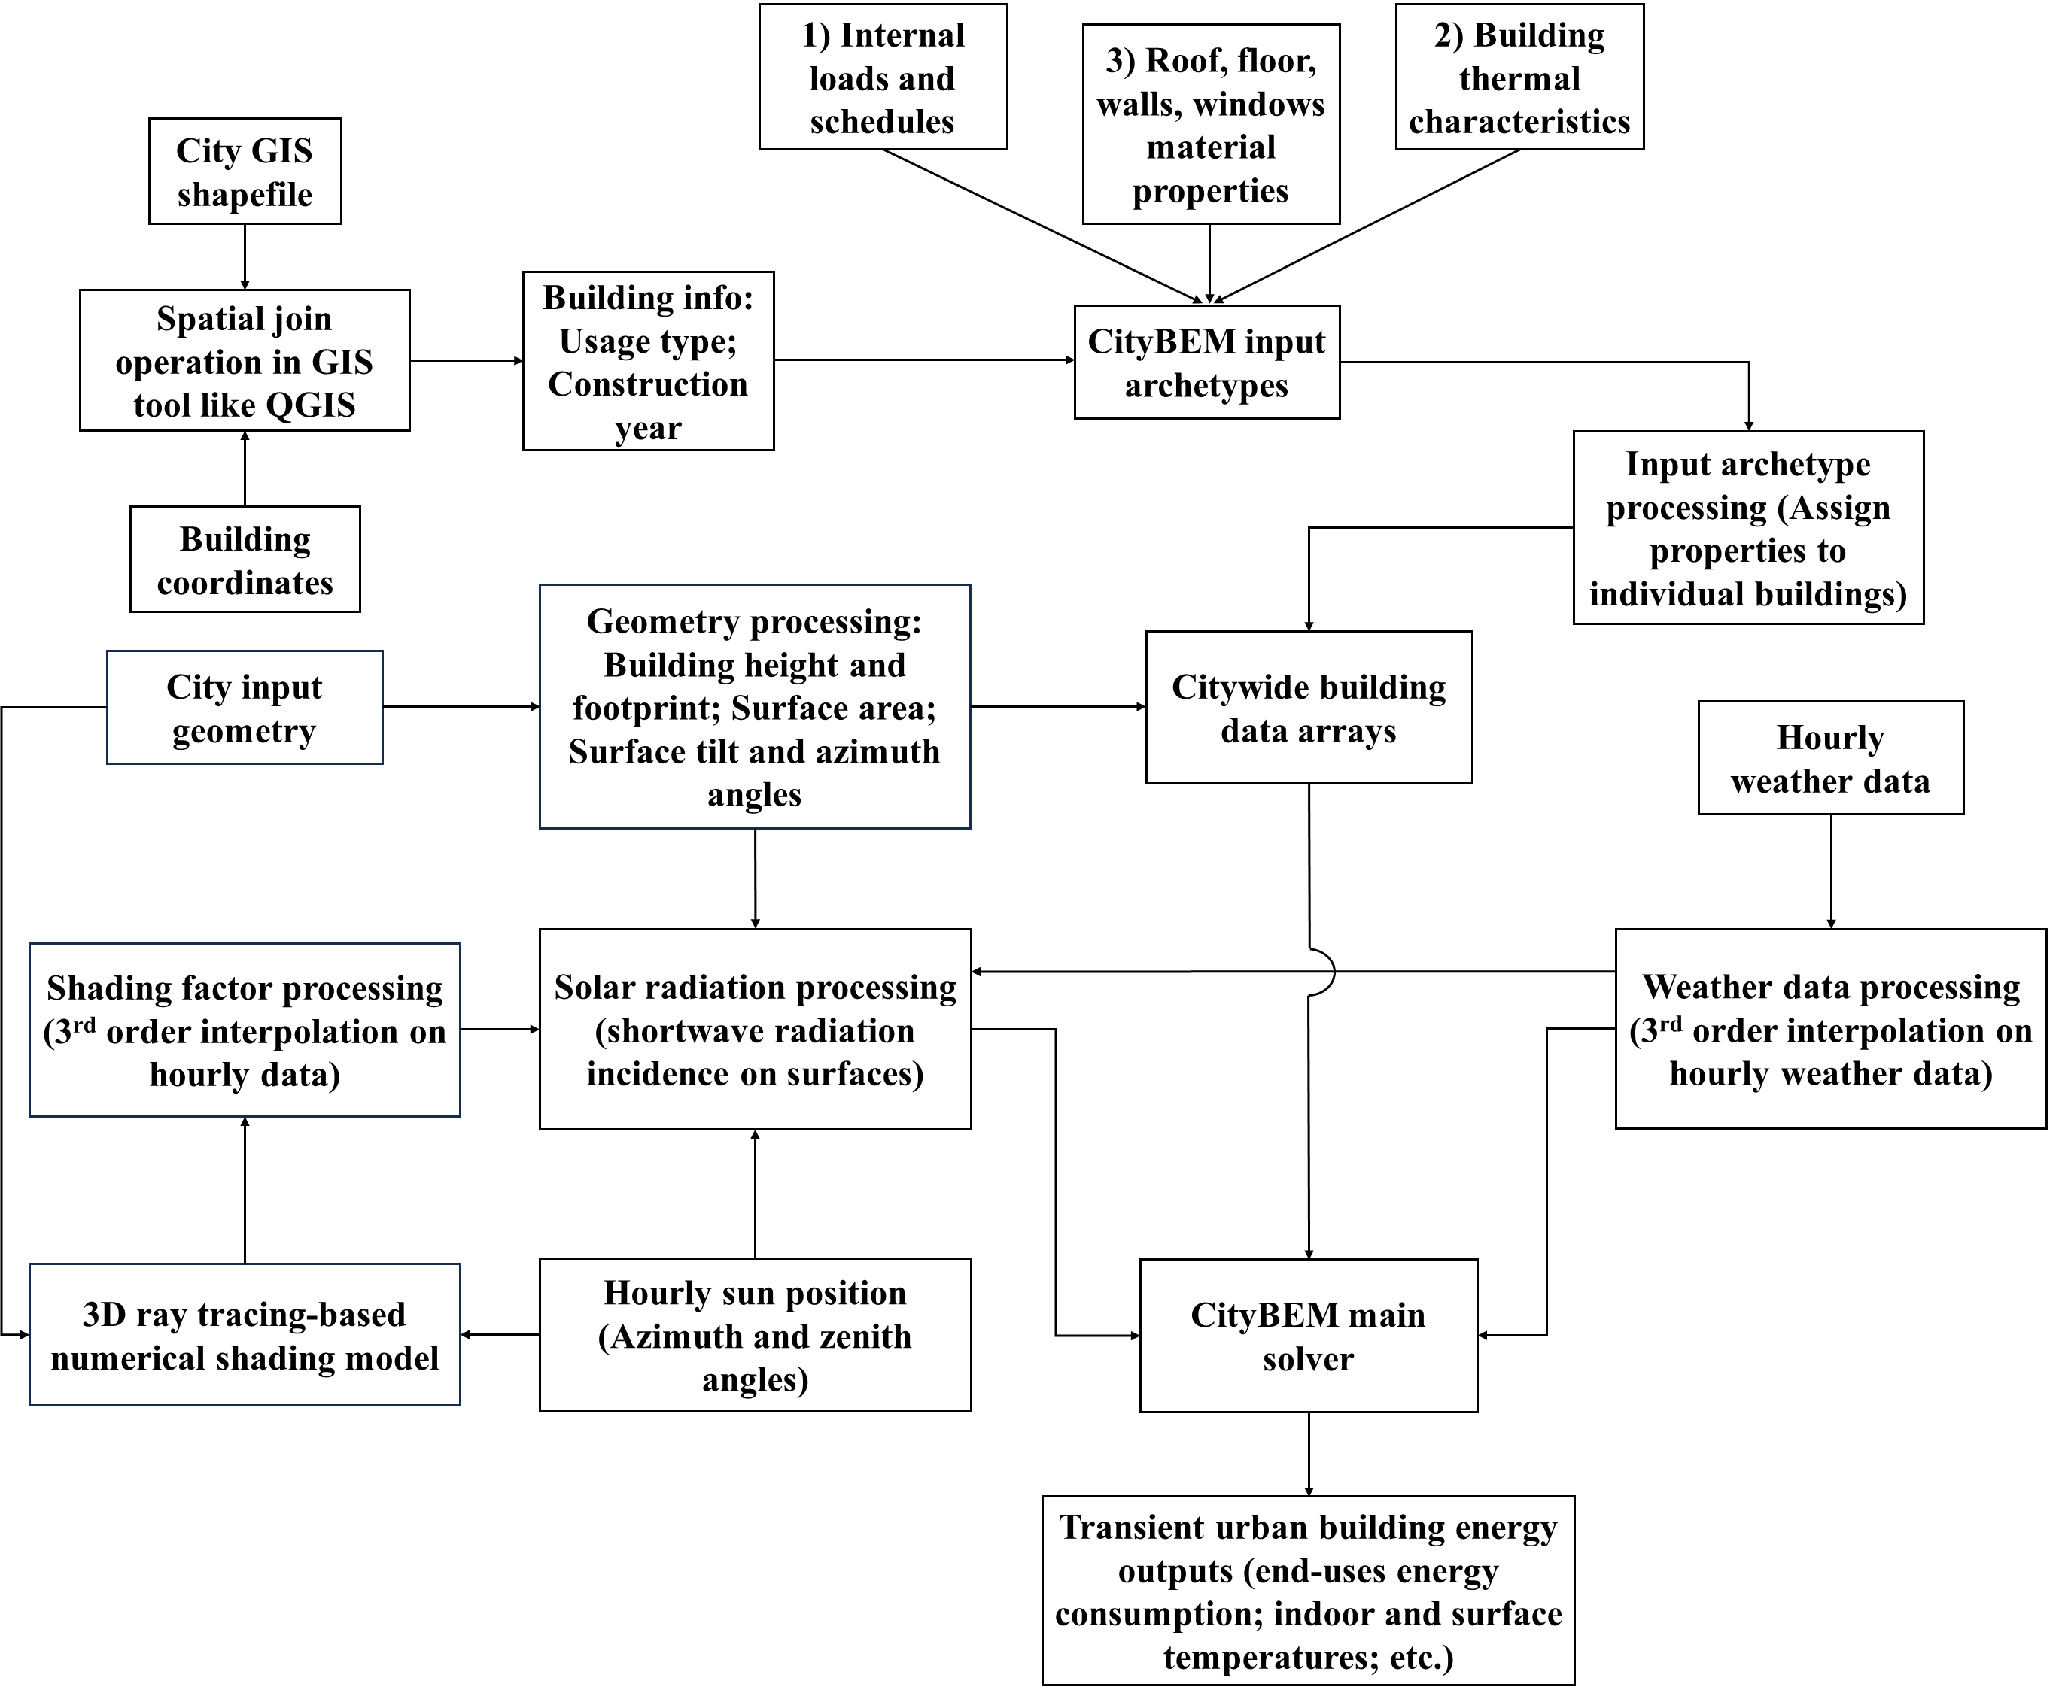
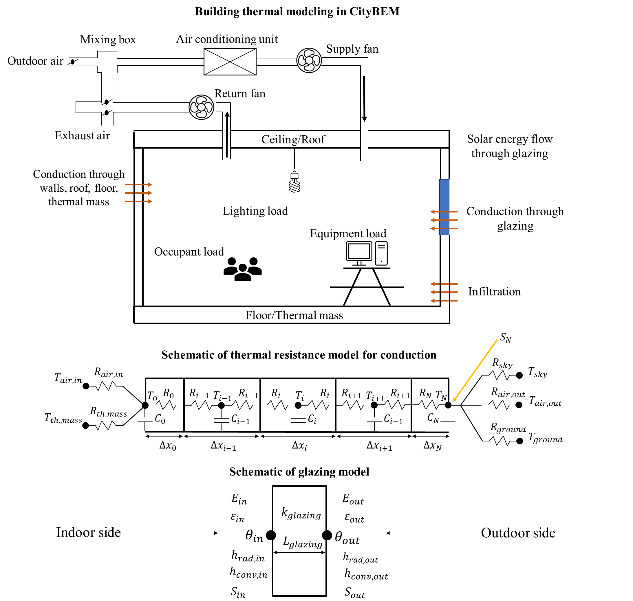
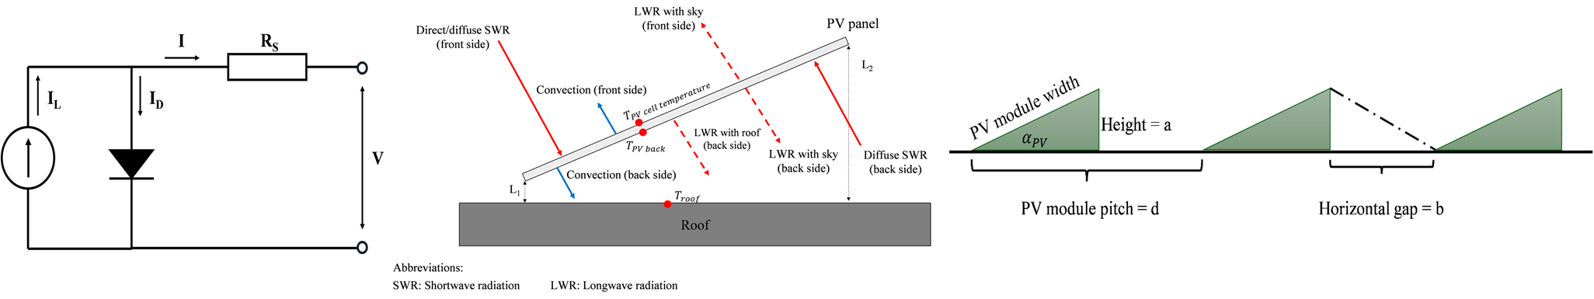
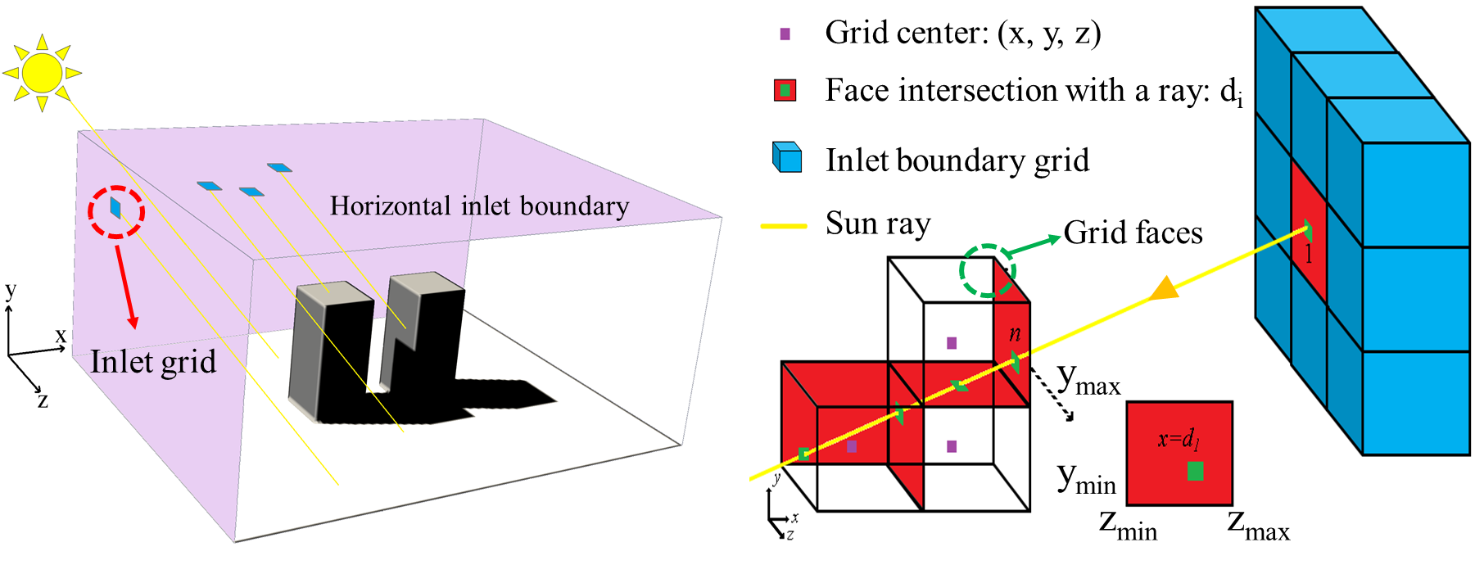
CityBEM Theoretical Foundation
Building geometry processing
Solar radiation modeling
Building energy modeling approach
Major steps in CityBEM
Rooftop PV modeling (Crystalline PVs)
Inter-building shading modeling

Slide 12
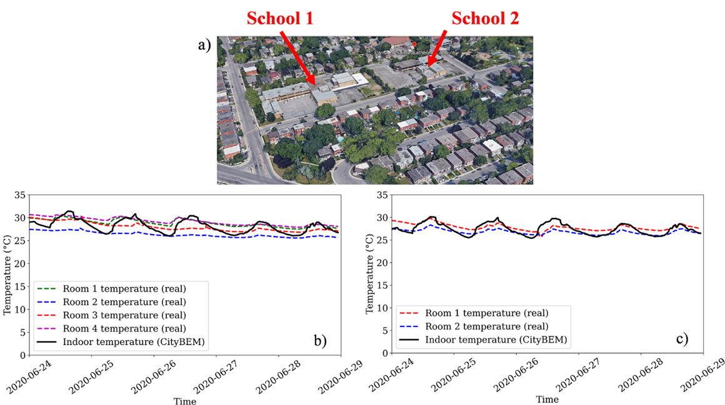
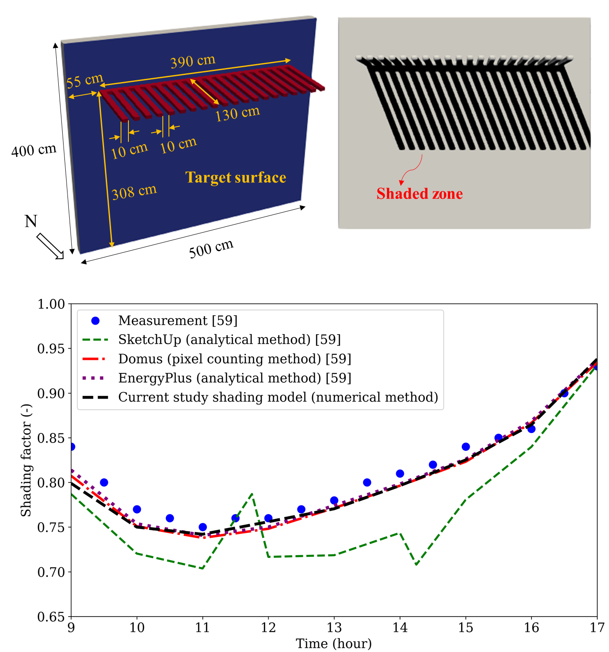
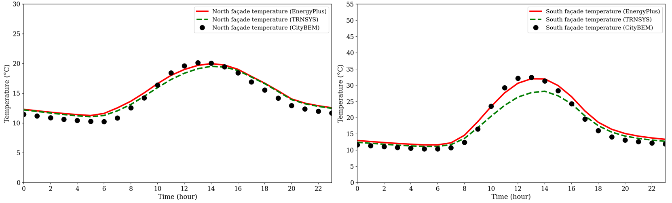
Model Validation and Verification
Average indoor air predictions
Annual EUI results
Shading model predictions
PV network output power simulation
Building surface temperature annual trend

Slide 13
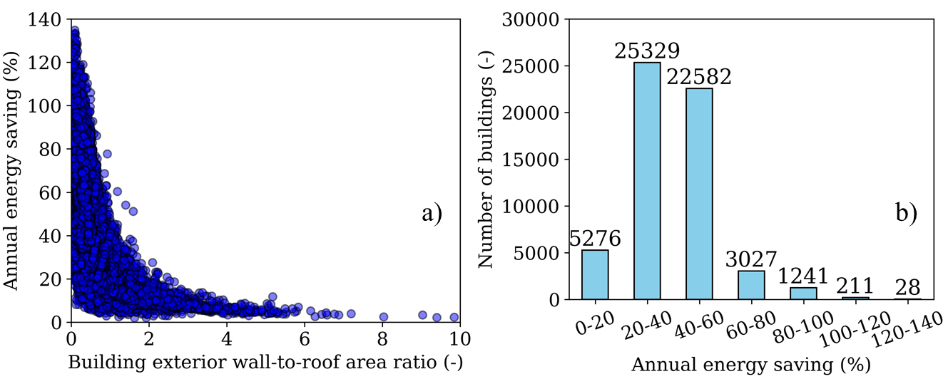
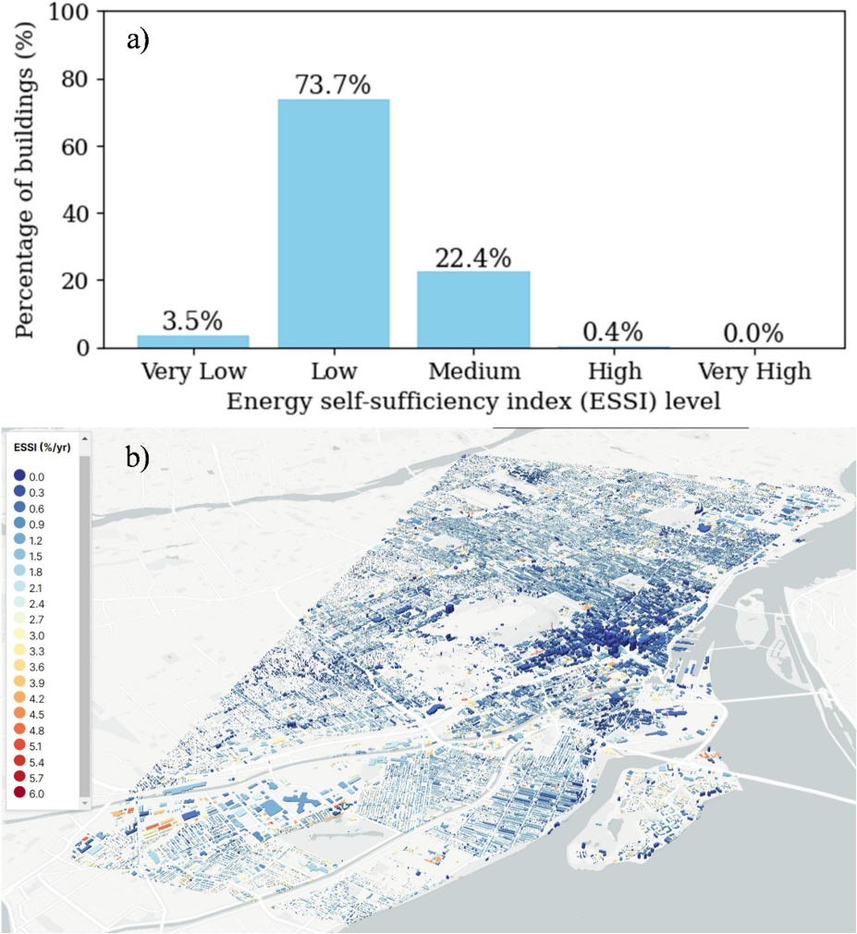
Simulation Results for the City of Montreal
Building info extraction (usage type, age, etc.)
Urban shading modeling
EUI of Montreal buildings
Labeling Montreal buildings for energy self-sufficiency level
Energy saving of PV retrofitting
3D geometry processing

